Slide 1
St. Louis Central Corridor West Building Permits
Monthly Report: September 2021

Slide 2
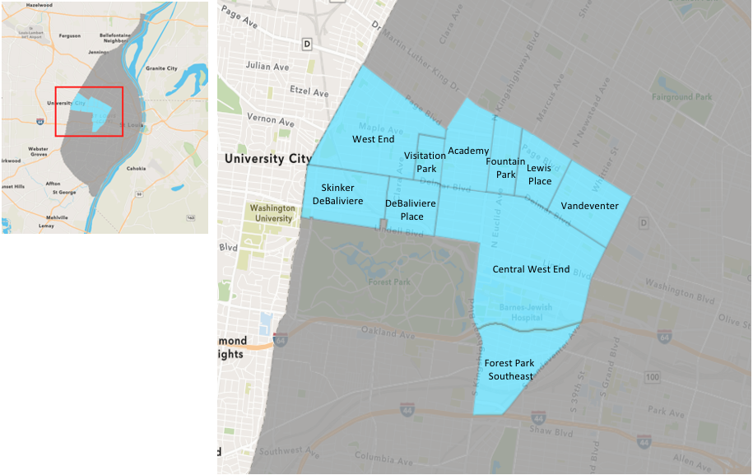
St. Louis Neighborhood Spatial Reference

Slide 3
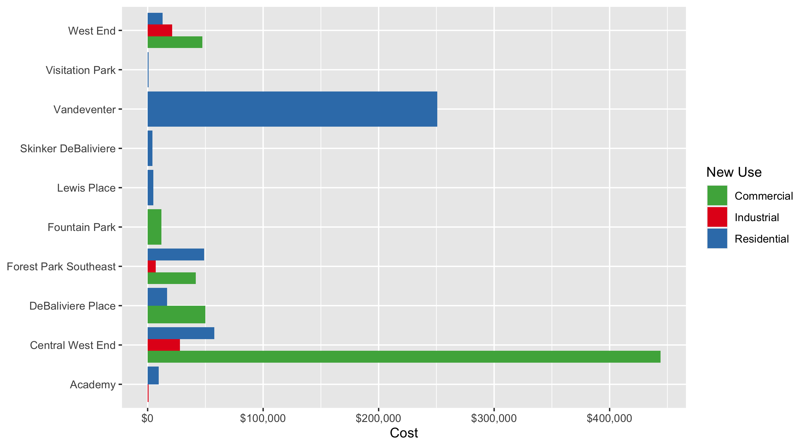
Neighborhood Summary: Average Building Permit Cost

Slide 4
Neighborhood Summary
September 2021 | September 2021 | September 2021 | September 2021
Neighborhood | Average Cost | # of Permits | Total Value of Permits
Academy | $8,228.571 | 7 | $57,600
Central West End | $178,228.000 | 35 | $6,237,980
DeBaliviere Place | $23,477.200 | 5 | $117,386
Forest Park Southeast | $43,392.857 | 14 | $607,500
Fountain Park | $12,000.000 | 1 | $12,000
Lewis Place | $5,000.000 | 1 | $5,000
Skinker DeBaliviere | $4,077.000 | 4 | $16,308
Vandeventer | $250,666.667 | 3 | $752,000
Visitation Park | $900.000 | 1 | $900
West End | $26,784.278 | 18 | $482,117
Last 6 Months | Last 6 Months | Last 6 Months | Last 6 Months
Neighborhood | Average Cost | # of Permits | Total Value of Permits
Academy | $32,500.68 | 22 | $715,015
Central West End | $1,384,889.47 | 257 | $355,916,594
DeBaliviere Place | $89,914.33 | 30 | $2,697,430
Forest Park Southeast | $521,427.16 | 116 | $60,485,551
Fountain Park | $284,738.92 | 13 | $3,701,606
Lewis Place | $102,289.92 | 12 | $1,227,479
Skinker DeBaliviere | $22,748.94 | 52 | $1,182,945
Vandeventer | $113,481.82 | 11 | $1,248,300
Visitation Park | $900.00 | 1 | $900
West End | $73,245.85 | 100 | $7,324,585

Slide 5
Core Neighborhoods

Slide 6
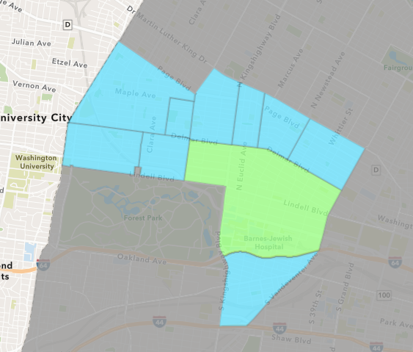
Central West End
September 2021 Neighborhood Cost Breakdown
Mean: $178,228
Median: $25,000
Range: $1,000 - $2,300,000

Slide 7
Central West End: Summary Notes
35 building permits in September 2021
-12.50% change compared to September 2020 (40 total building permits)
$178,228: Average building permit cost in September 2021
126.38% change compared to September 2020 ($78,730)
316 total building permits in 2021
7.48% change YTD compared to this time in 2020 (294 total building permits)
$1,140,090: YTD average building permit cost in 2021
269.45% change YTD compared to this time in 2020 ($308,595)

Slide 8
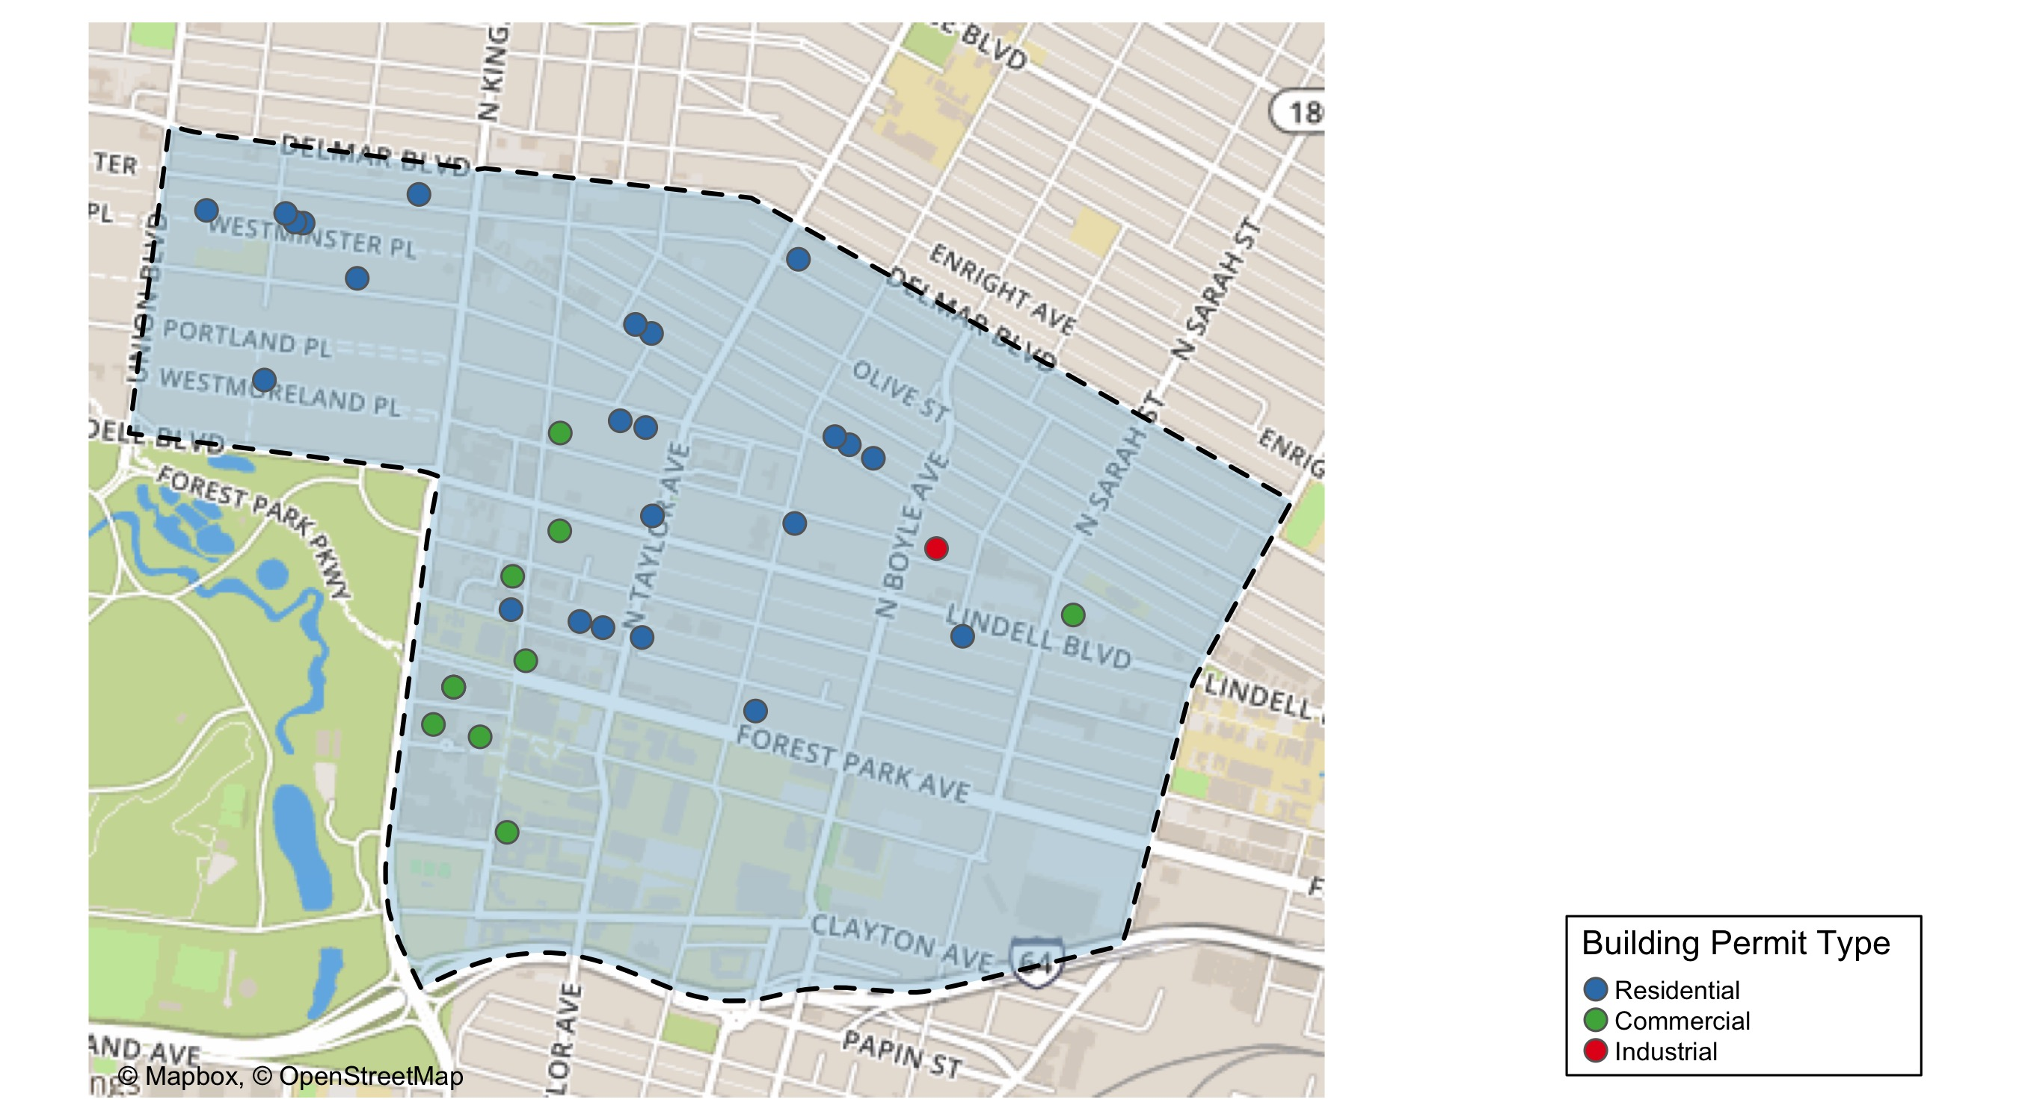
Central West End

Slide 9
Neighborhood Summary
September 2021 | September 2021 | September 2021 | September 2021
Permit Use | Average Cost | # of Permits | Total Value of Permits
Commercial | $443,981.8 | 11 | $4,883,800
Industrial | $28,000.0 | 1 | $28,000
Residential | $57,660.0 | 23 | $1,326,180
Last 6 Months | Last 6 Months | Last 6 Months | Last 6 Months
Permit Use | Average Cost | # of Permits | Total Value of Permits
Commercial | $3,573,799.10 | 88 | $314,494,321
Industrial | $2,332,943.00 | 14 | $32,661,202
Residential | $56,523.04 | 155 | $8,761,071

Slide 10
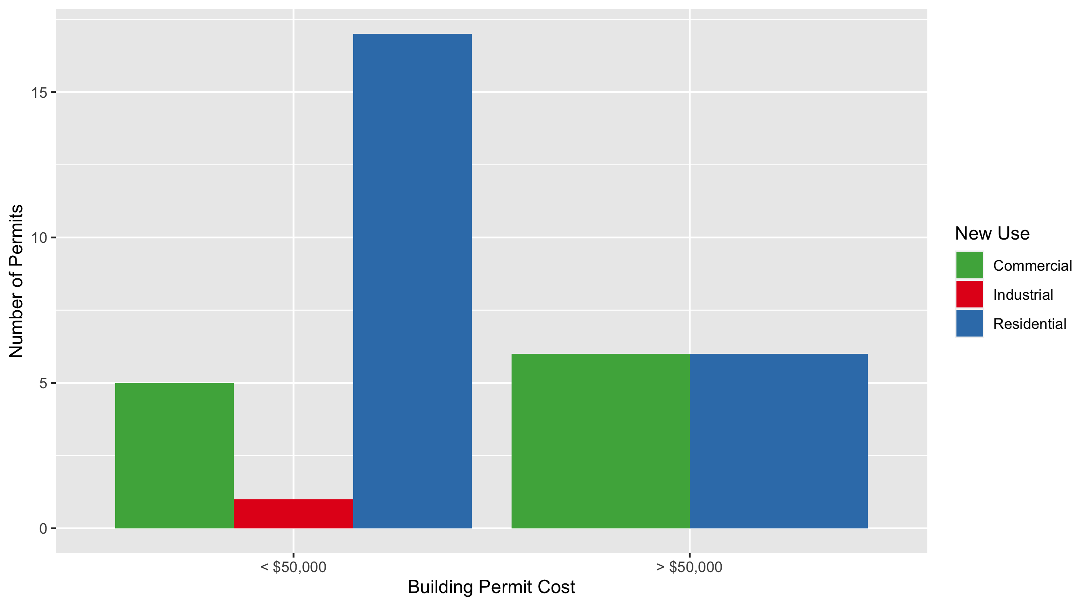
Central West End Permit Cost Breakdown

Slide 11
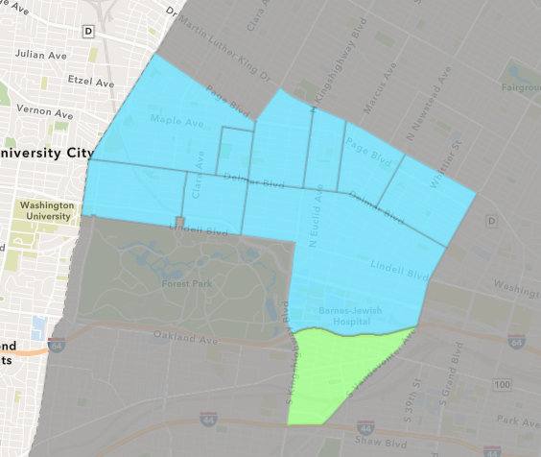
Forest Park Southeast
September 2021 Neighborhood Cost Breakdown
Mean: $43,393
Median: $8,500
Range: $500 - $192,000

Slide 12
Forest Park Southeast: Summary Notes
14 building permits in September 2021
40.00% change compared to September 2020 (10 total building permits)
$43,393: Average building permit cost in September 2021
3.91% change compared to September 2020 ($41,760)
136 total building permits in 2021
63.86% change YTD compared to this time in 2020 (83 total building permits)
$458,652: YTD average building permit cost in 2021
137.89% change YTD compared to this time in 2020 ($192,796)

Slide 13
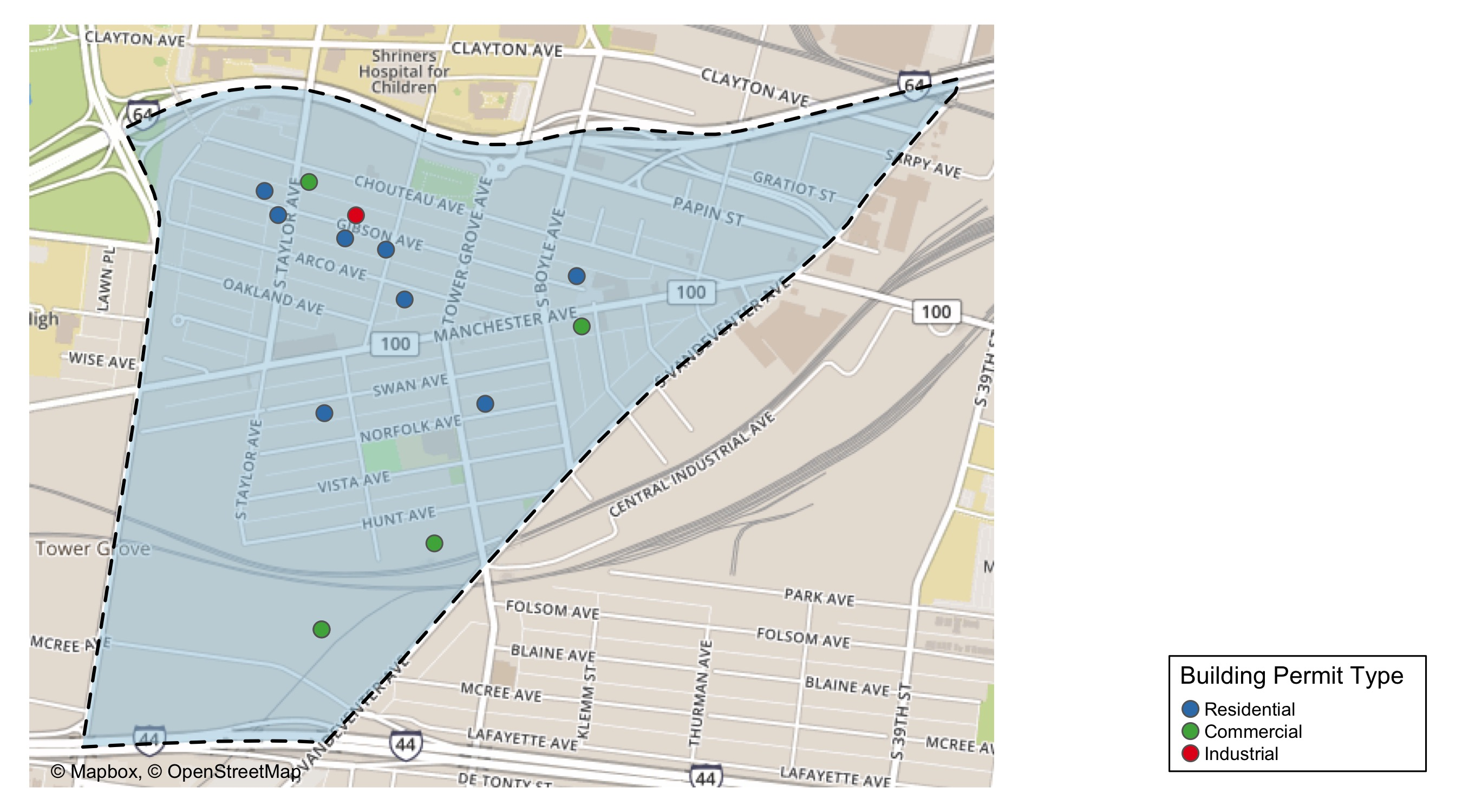
Forest Park Southeast

Slide 14
Neighborhood Summary
September 2021 | September 2021 | September 2021 | September 2021
Permit Use | Average Cost | # of Permits | Total Value of Permits
Commercial | $41,800.0 | 5 | $209,000
Industrial | $7,000.0 | 1 | $7,000
Residential | $48,937.5 | 8 | $391,500
Last 6 Months | Last 6 Months | Last 6 Months | Last 6 Months
Permit Use | Average Cost | # of Permits | Total Value of Permits
Commercial | $170,936.50 | 24 | $4,102,476
Industrial | $11,065.56 | 9 | $99,590
Residential | $678,114.28 | 83 | $56,283,485

Slide 15
Forest Park Southeast Individual Permit Breakdown
nbhd_name | Owner | New Use | Cost | address
Forest Park Southeast | CRAIG, ETHAN & ANNIE HESS | Industrial | $7,000 | 4429 GIBSON AV
Forest Park Southeast | HTE HOUSING LLC | Residential | $128,000 | 4334 ARCO AV
Forest Park Southeast | PARK EAST II LP | Residential | $85,000 | 4400 GIBSON AV
Forest Park Southeast | GELVEN PROPERTIES LLC | Residential | $89,000 | 4521 GIBSON AV
Forest Park Southeast | JEMZ INVESTMENTS & PROPERTIES LLC | Residential | $65,000 | 4418 SWAN AV
Forest Park Southeast | KENRICK, JEROME & LARRY W RICHIE JR | Residential | $15,000 | 4225-4227 GIBSON AV
Forest Park Southeast | GREEN ST 4565 MCREE INVESTORS LLC AT | Commercial | $10,000 | 4565 MCREE AV
Forest Park Southeast | GREEN ST 4565 MCREE INVESTORS LLC AT | Commercial | $5,000 | 4565 MCREE AV
Forest Park Southeast | WOODWARD LOFTS LLC | Commercial | $192,000 | 1519 TOWER GROVE AV
Forest Park Southeast | RICE, MINNIE D & MINNIE E ELLIS | Residential | $7,000 | 4432 GIBSON AV
Forest Park Southeast | PARK EAST II LP | Residential | $500 | 1035-37 S TAYLOR AV
Forest Park Southeast | ODUYE, ADEDAPO A | Commercial | $500 | 4470 CHOUTEAU AV
Forest Park Southeast | FAIRPOINT HOMES LLC | Residential | $2,000 | 4253 NORFOLK AV
Forest Park Southeast | GROVE EQUITIES LLC | Commercial | $1,500 | 4178-82 MANCHESTER AV

Slide 16
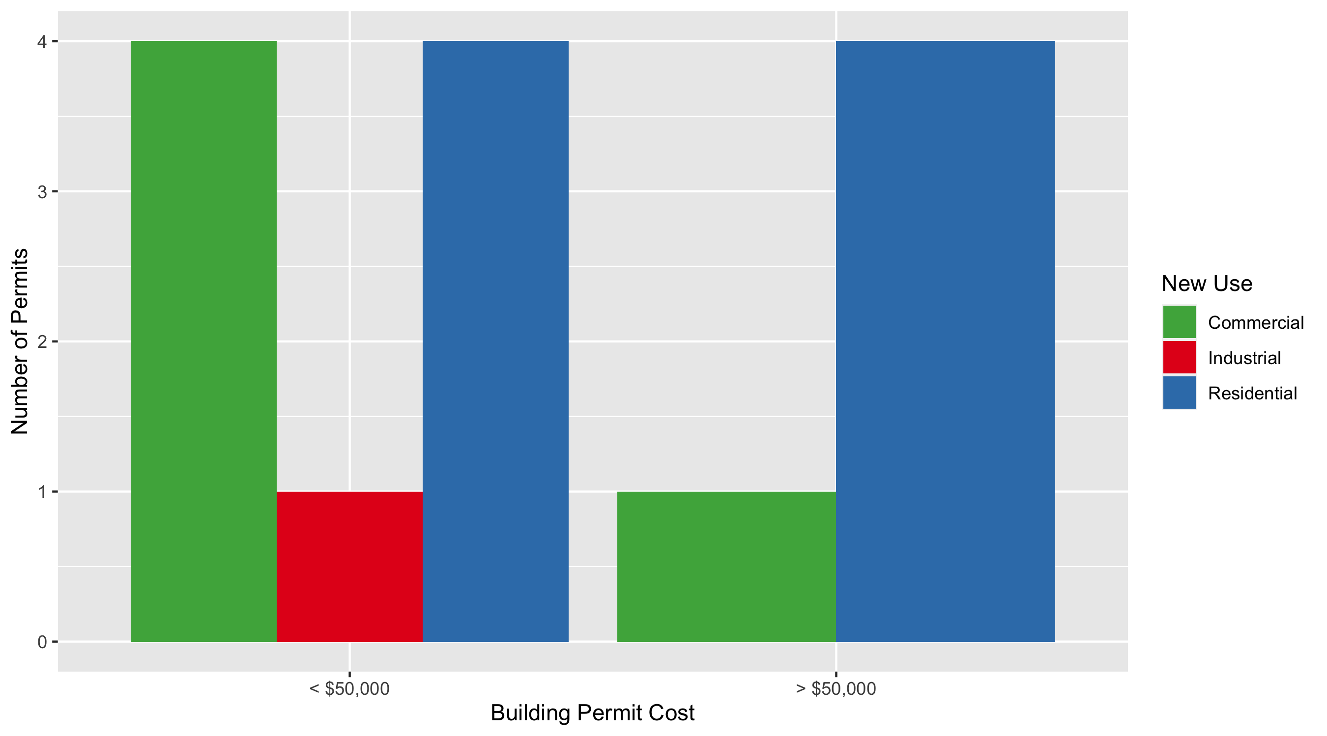
Forest Park Southeast Permit Cost Breakdown

Slide 17
Expanded Service Area

Slide 18
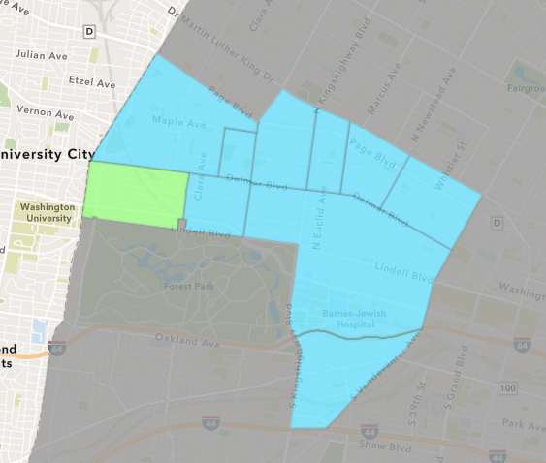
Skinker DeBaliviere
September 2021 Neighborhood Cost Breakdown
Mean: $4,077
Median: $4,159
Range: $3,000 - $4,990

Slide 19
Skinker DeBaliviere: Summary Notes
4 building permits in September 2021
-69.23% change compared to September 2020 (13 total building permits)
$4,077: Average building permit cost in September 2021
-97.49% change compared to September 2020 ($162,435)
69 total building permits in 2021
-23.33% change YTD compared to this time in 2020 (90 total building permits)
$25,726: YTD average building permit cost in 2021
-96.40% change YTD compared to this time in 2020 ($715,442)

Slide 20
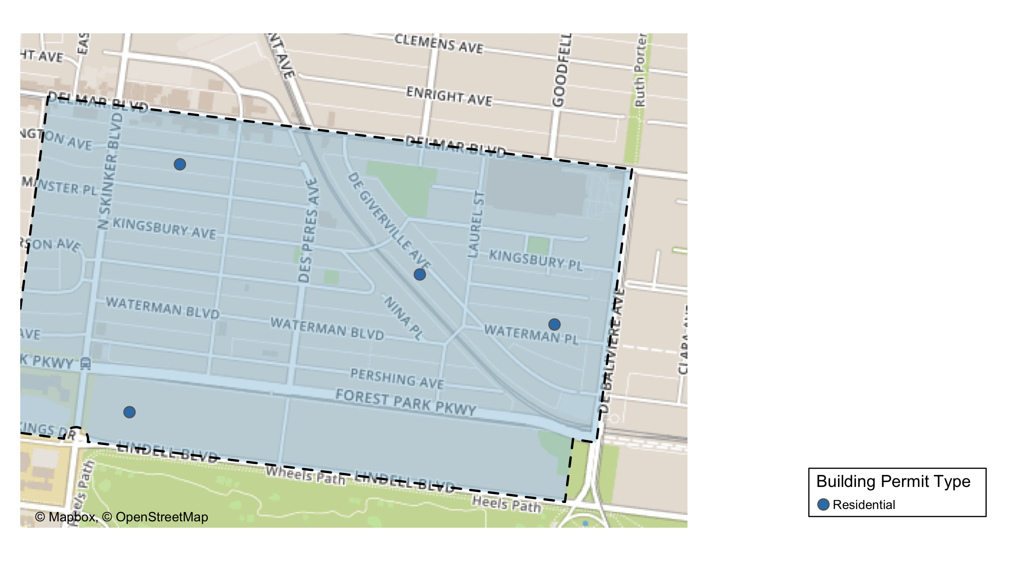
Skinker DeBaliviere

Slide 21
Neighborhood Summary
September 2021 | September 2021 | September 2021 | September 2021
Permit Use | Average Cost | # of Permits | Total Value of Permits
Commercial | $0 | 0 | $0
Industrial | $0 | 0 | $0
Residential | $4,077 | 4 | $16,308
Last 6 Months | Last 6 Months | Last 6 Months | Last 6 Months
Permit Use | Average Cost | # of Permits | Total Value of Permits
Commercial | $40,000.00 | 4 | $160,000
Industrial | $17,500.00 | 2 | $35,000
Residential | $21,477.07 | 46 | $987,945

Slide 22
Skinker DeBaliviere Individual Permit Breakdown
nbhd_name | Owner | New Use | Cost | address
Skinker DeBaliviere | BONAN, F WILLIAM | Residential | $4,168 | 6159 LINDELL BLVD
Skinker DeBaliviere | SIMPSON, KENYA | Residential | $4,150 | 5844 DEGIVERVILLE AV
Skinker DeBaliviere | MCWILLIAMS, SEAN | Residential | $4,990 | 6144 WASHINGTON AV
Skinker DeBaliviere | HARRISON, TIMOTHY & MEGAN | Residential | $3,000 | 5745 WATERMAN BLVD

Slide 23
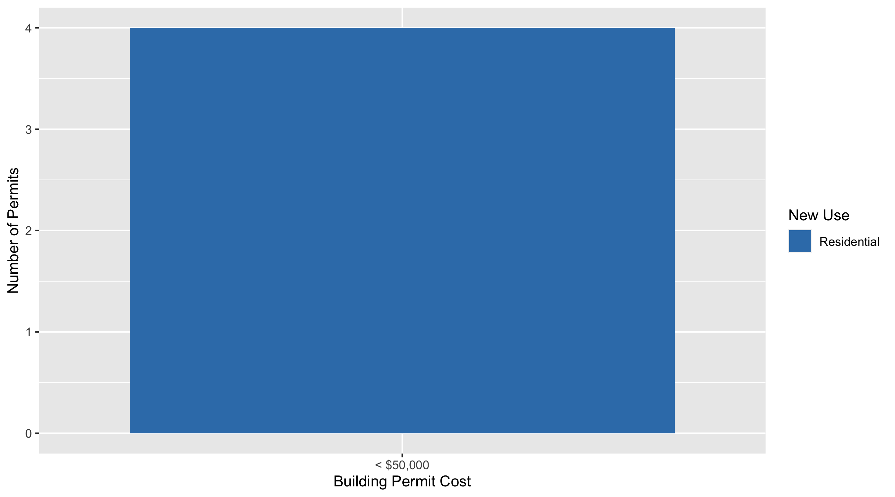
Skinker DeBaliviere Permit Cost Breakdown

Slide 24
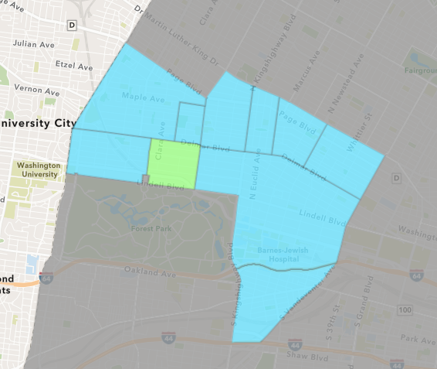
DeBaliviere Place
September 2021 Neighborhood Cost Breakdown
Mean: $23,477
Median: $7,500
Range: $900 - $55,986

Slide 25
DeBaliviere Place: Summary Notes
5 building permits in September 2021
25.00% change compared to September 2020 (4 total building permits)
$23,477: Average building permit cost in September 2021
89.77% change compared to September 2020 ($12,372)
43 total building permits in 2021
59.26% change YTD compared to this time in 2020 (27 total building permits)
$81,837: YTD average building permit cost in 2021
-42.66% change YTD compared to this time in 2020 ($142,727)

Slide 26
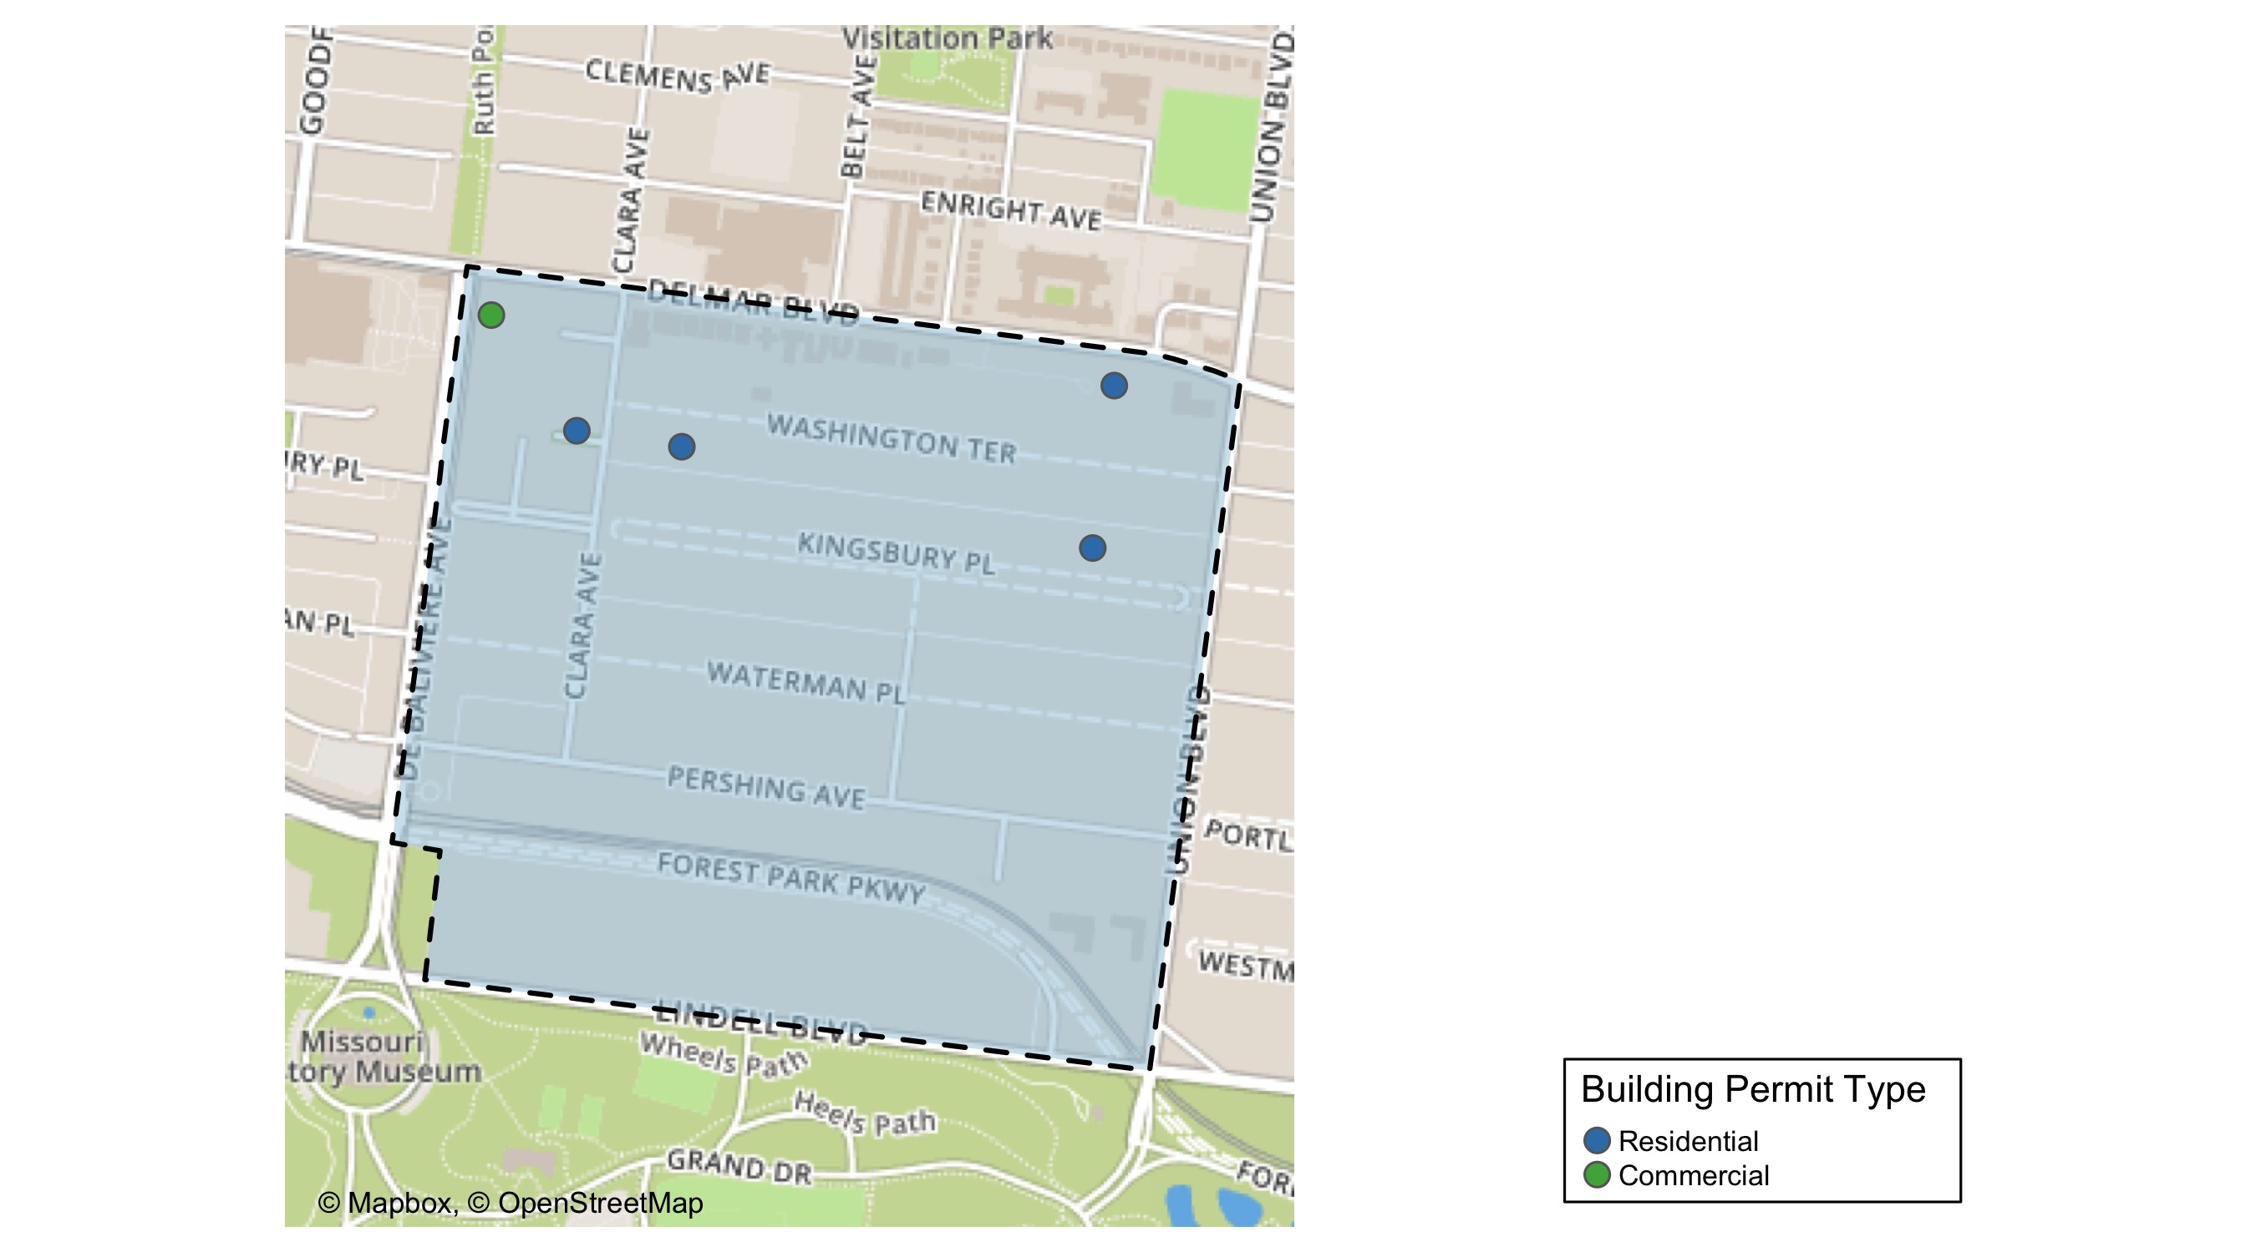
DeBaliviere Place

Slide 27
Neighborhood Summary
September 2021 | September 2021 | September 2021 | September 2021
Permit Use | Average Cost | # of Permits | Total Value of Permits
Commercial | $50,000.0 | 1 | $50,000
Industrial | $0.0 | 0 | $0
Residential | $16,846.5 | 4 | $67,386
Last 6 Months | Last 6 Months | Last 6 Months | Last 6 Months
Permit Use | Average Cost | # of Permits | Total Value of Permits
Commercial | $48,479.20 | 5 | $242,396
Industrial | $63,500.00 | 1 | $63,500
Residential | $99,647.25 | 24 | $2,391,534

Slide 28
DeBaliviere Place Individual Permit Breakdown
nbhd_name | Owner | New Use | Cost | address
DeBaliviere Place | 5654 DELMAR LLC P | Commercial | $50,000 | 566 DEBALIVIERE AV
DeBaliviere Place | RB DELMAR LLC | Residential | $900 | 5340 DELMAR BLVD
DeBaliviere Place | MIL;LER, JAMES E & ELAINE D | Residential | $3,000 | 44 WASHINGTON TER
DeBaliviere Place | WILLIAMS, CHRISTOPHER & BROOKE | Residential | $7,500 | 9 KINGSBURY PL
DeBaliviere Place | 527-533 CLARA CONDOMINIUM | Residential | $55,986 | 527 CLARA AV

Slide 29
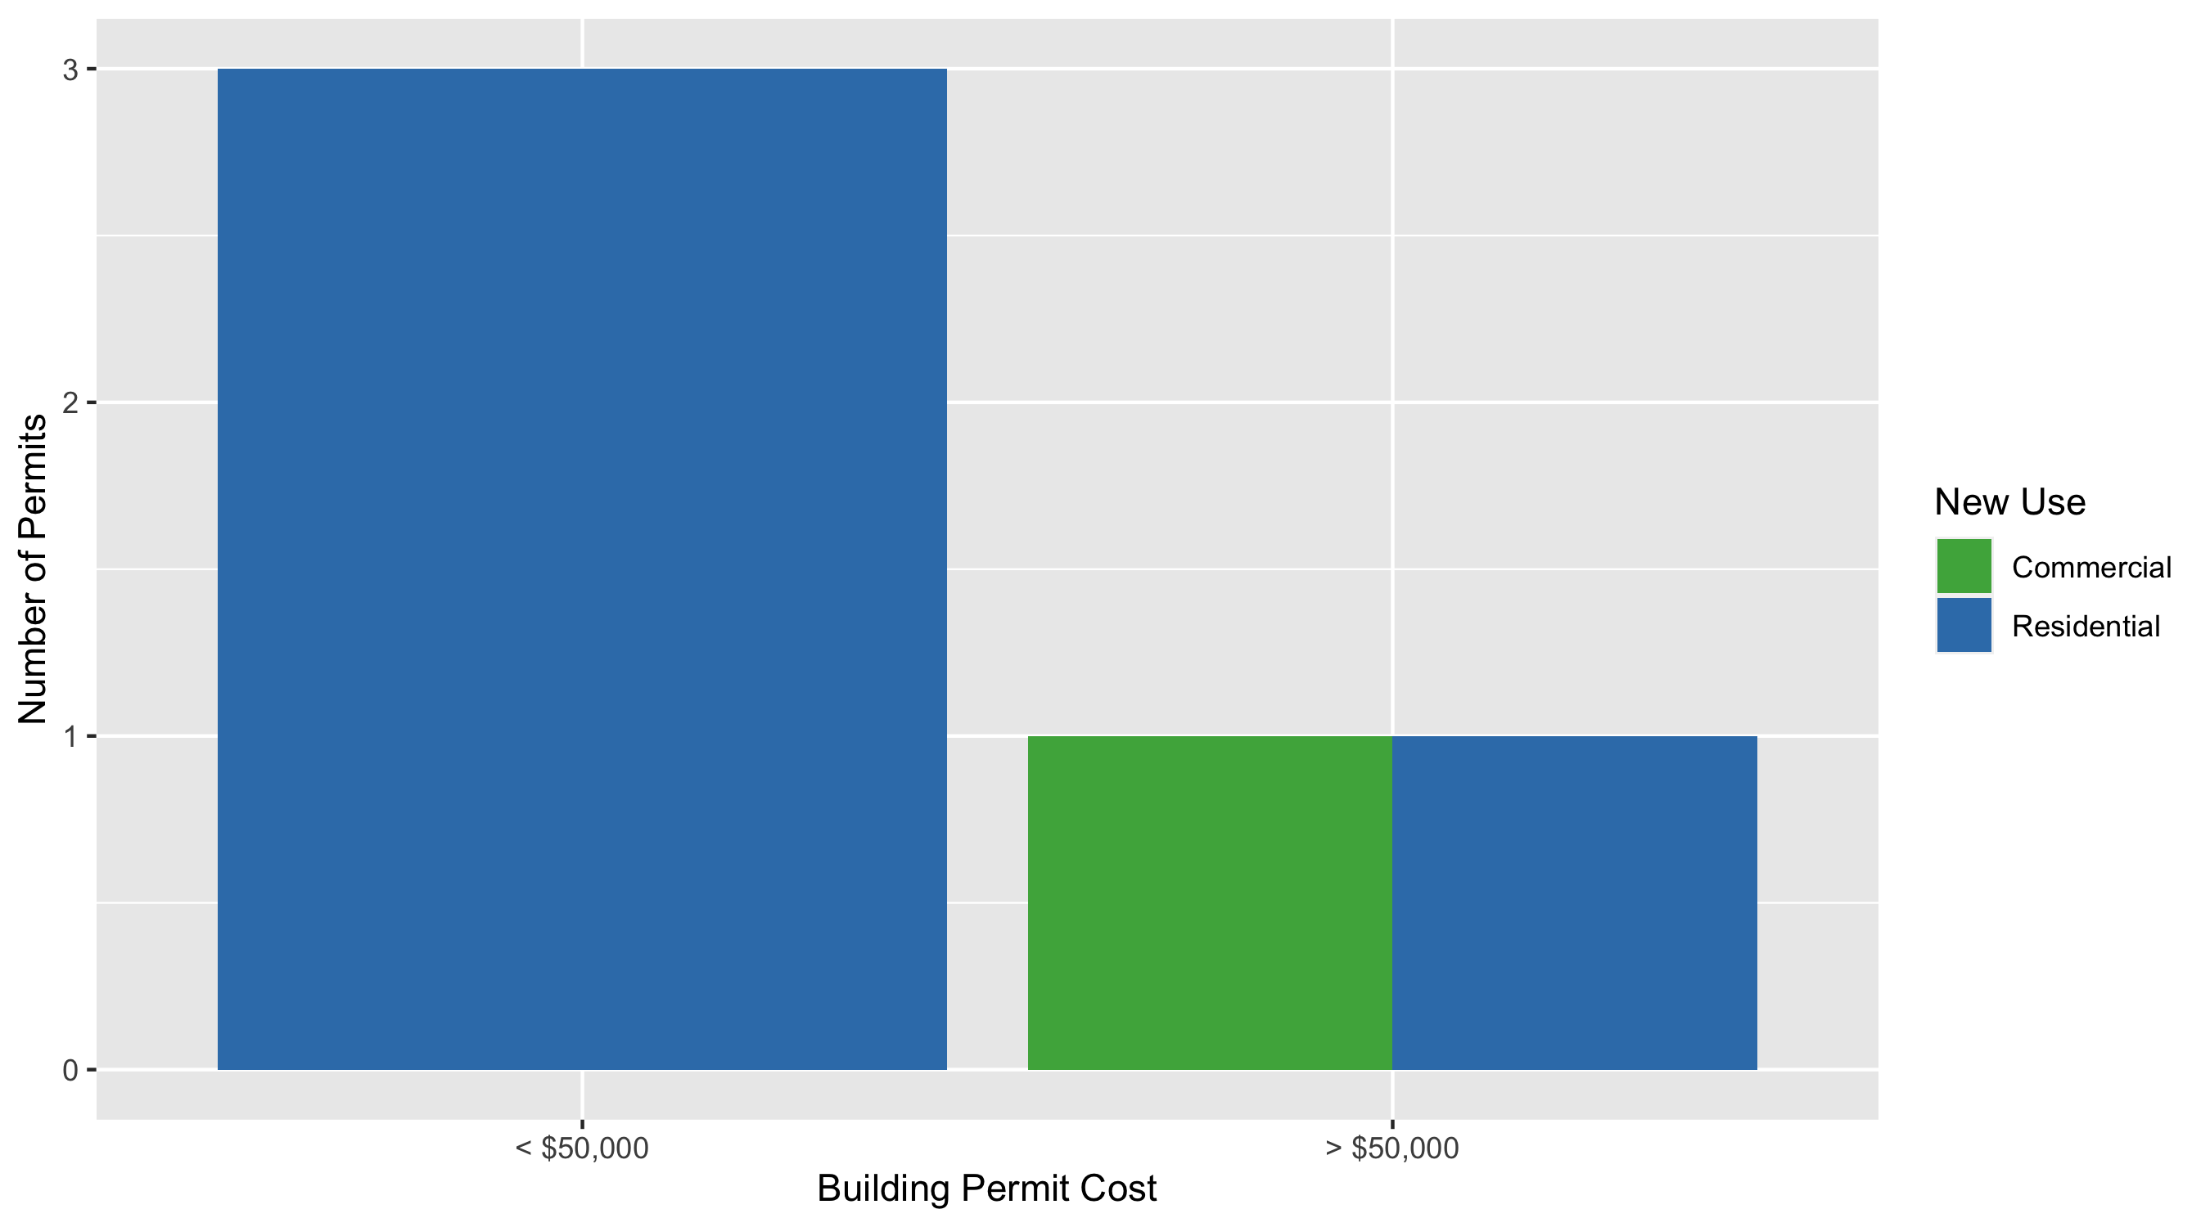
DeBaliviere Place Permit Cost Breakdown

Slide 30
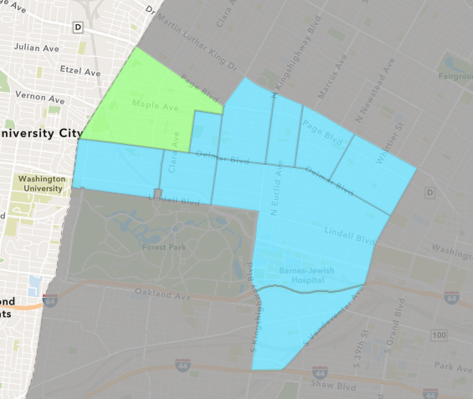
West End
September 2021 Neighborhood Cost Breakdown
Mean: $26,784
Median: $4,356
Range: $1,000 - $300,000

Slide 31
West End: Summary Notes
18 building permits in September 2021
63.64% change compared to September 2020 (11 total building permits)
$26,784: Average building permit cost in September 2021
131.08% change compared to September 2020 ($11,591)
116 total building permits in 2021
87.10% change YTD compared to this time in 2020 (62 total building permits)
$79,656: YTD average building permit cost in 2021
-72.65% change YTD compared to this time in 2020 ($291,236)

Slide 32
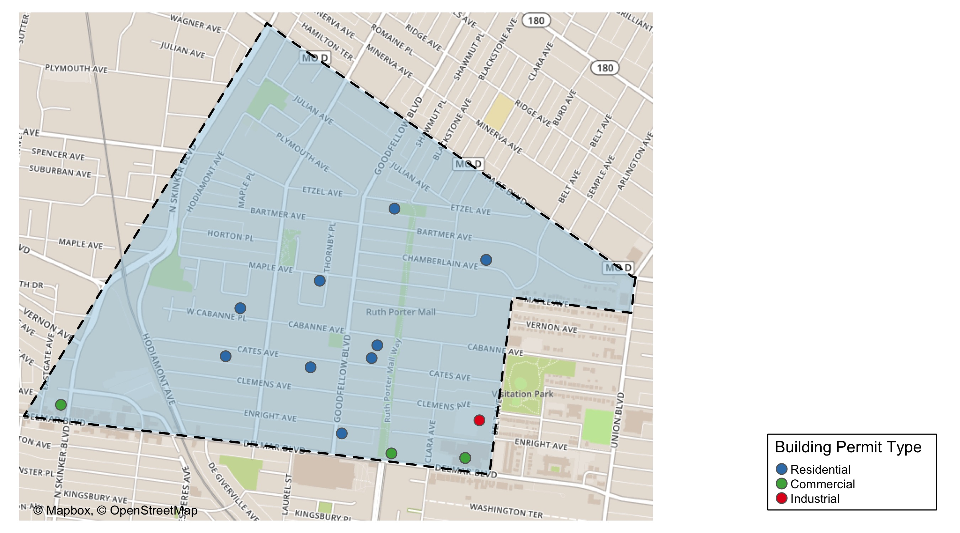
West End

Slide 33
Neighborhood Summary
September 2021 | September 2021 | September 2021 | September 2021
Permit Use | Average Cost | # of Permits | Total Value of Permits
Commercial | $47,417 | 7 | $331,919
Industrial | $21,198 | 1 | $21,198
Residential | $12,900 | 10 | $129,000
Last 6 Months | Last 6 Months | Last 6 Months | Last 6 Months
Permit Use | Average Cost | # of Permits | Total Value of Permits
Commercial | $52,776.88 | 40 | $2,111,075
Industrial | $25,092.20 | 5 | $125,461
Residential | $92,509.98 | 55 | $5,088,049

Slide 34
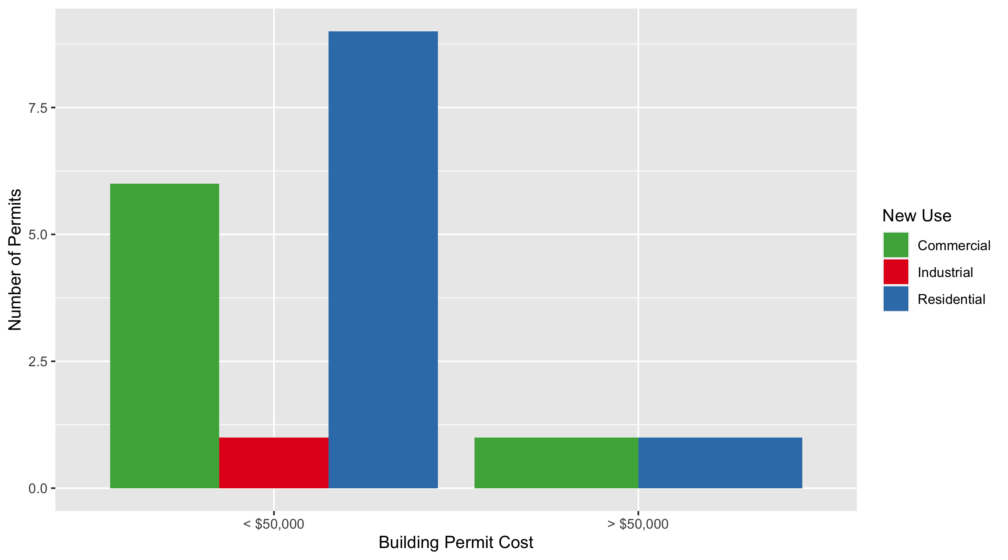
West End Permit Cost Breakdown

Slide 35
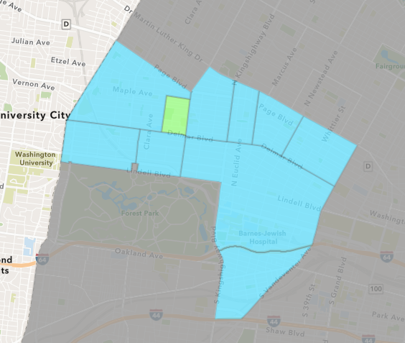
Visitation Park
September 2021 Neighborhood Cost Breakdown
Mean: $900
Median: $900
Range: $900 - $900

Slide 36
Visitation Park: Summary Notes
1 building permits in September 2021
0.00% change compared to September 2020 (1 total building permits)
$900: Average building permit cost in September 2021
-85.94% change compared to September 2020 ($6,400)
1 total building permits in 2021
-83.33% change YTD compared to this time in 2020 (6 total building permits)
$900: YTD average building permit cost in 2021
-95.07% change YTD compared to this time in 2020 ($18,242)

Slide 37
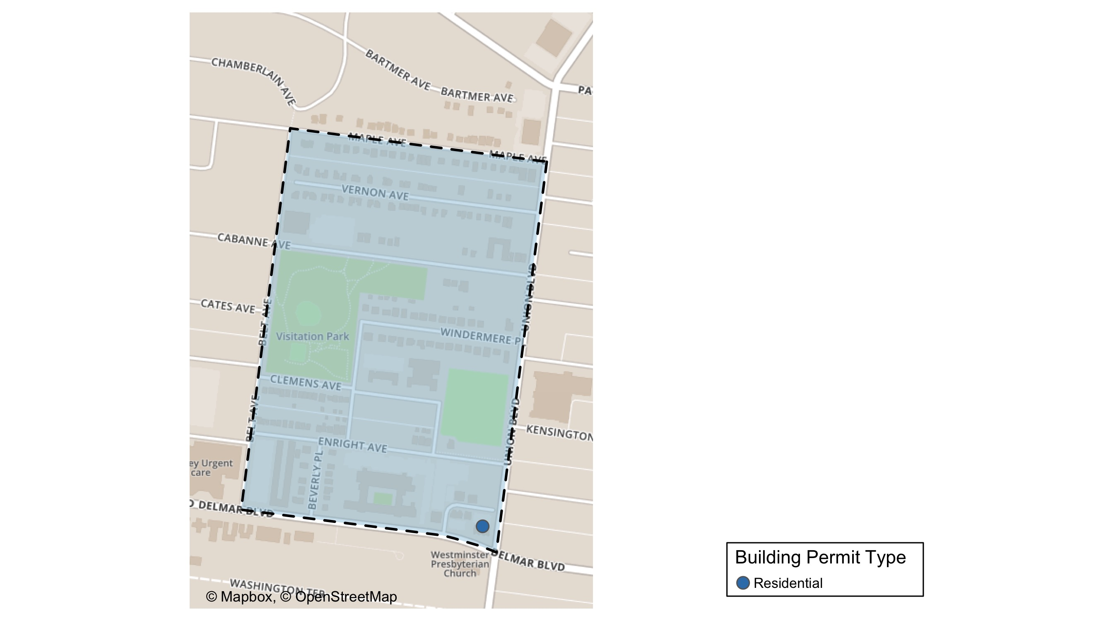
Visitation Park

Slide 38
Neighborhood Summary
September 2021 | September 2021 | September 2021 | September 2021
Permit Use | Average Cost | # of Permits | Total Value of Permits
Commercial | $0 | 0 | $0
Industrial | $0 | 0 | $0
Residential | $900 | 1 | $900
Last 6 Months | Last 6 Months | Last 6 Months | Last 6 Months
Permit Use | Average Cost | # of Permits | Total Value of Permits
Commercial | $0 | 0 | $0
Industrial | $0 | 0 | $0
Residential | $900 | 1 | $900

Slide 39
Visitation Park Individual Permit Breakdown
nbhd_name | Owner | New Use | Cost | address
Visitation Park | RB DELMAR LLC | Residential | $900 | 5305 DELMAR BLVD

Slide 40
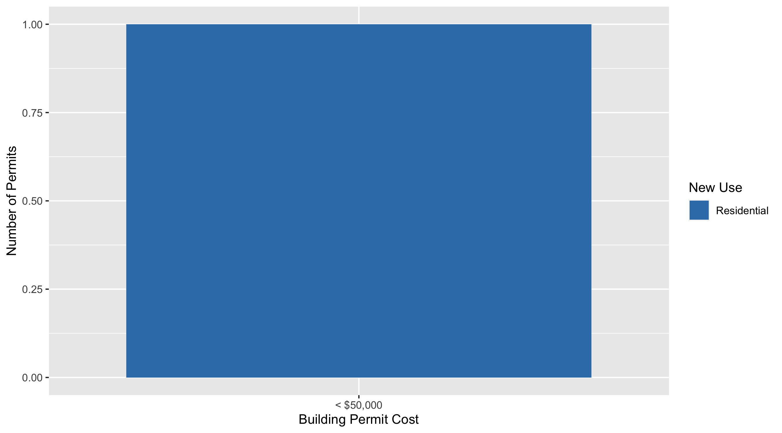
Visitation Park Permit Cost Breakdown

Slide 41
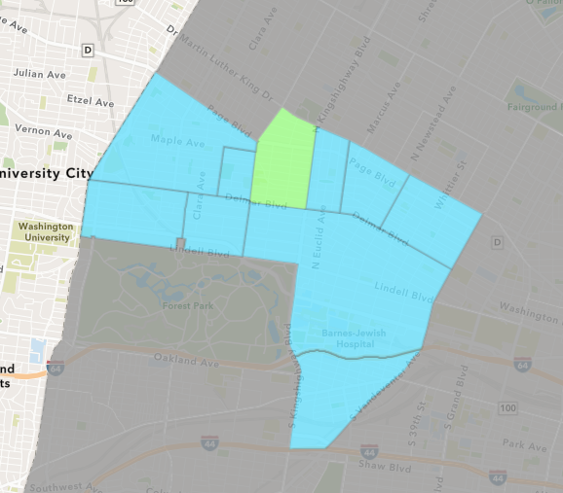
Academy
September 2021 Neighborhood Cost Breakdown
Mean: $8,229
Median: $900
Range: $300 - $50,000

Slide 42
Academy: Summary Notes
7 building permits in September 2021
75.00% change compared to September 2020 (4 total building permits)
$8,229: Average building permit cost in September 2021
-80.67% change compared to September 2020 ($42,568)
26 total building permits in 2021
4.00% change YTD compared to this time in 2020 (25 total building permits)
$35,911: YTD average building permit cost in 2021
-32.75% change YTD compared to this time in 2020 ($53,403)

Slide 43
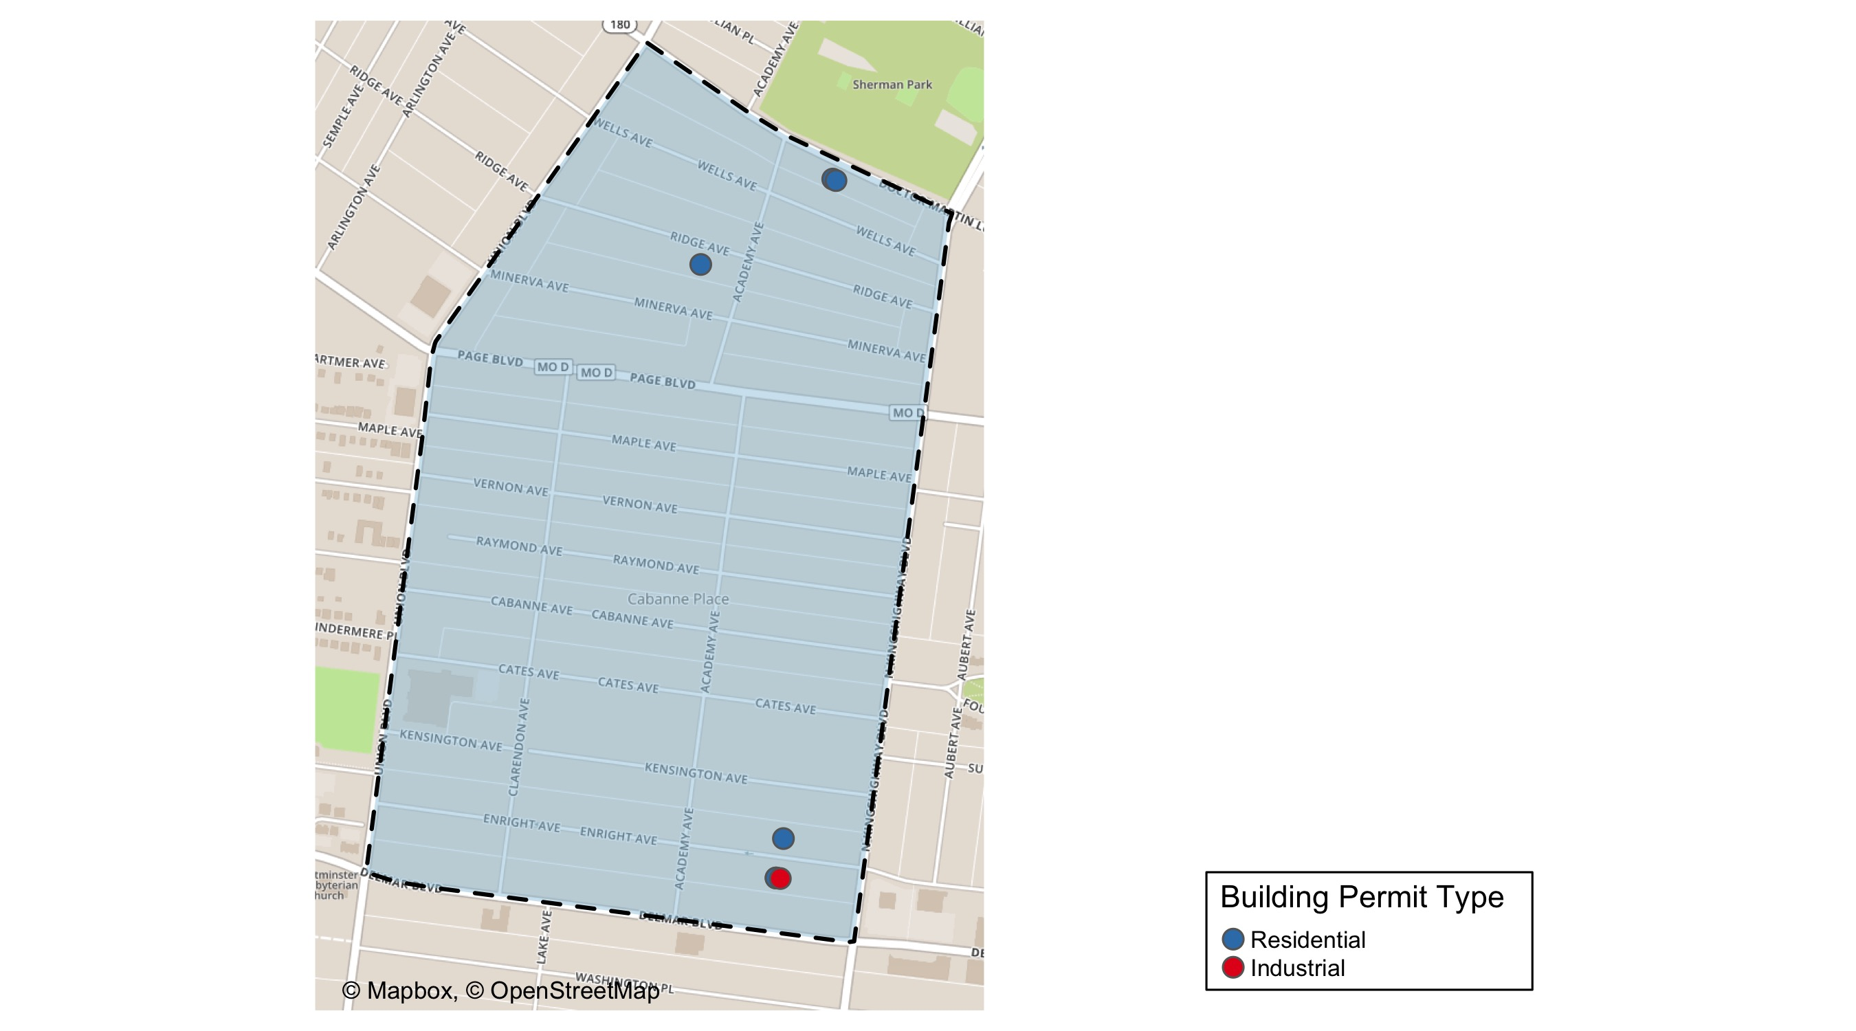
Academy

Slide 44
Neighborhood Summary
September 2021 | September 2021 | September 2021 | September 2021
Permit Use | Average Cost | # of Permits | Total Value of Permits
Commercial | $0 | 0 | $0
Industrial | $750 | 1 | $750
Residential | $9,475 | 6 | $56,850
Last 6 Months | Last 6 Months | Last 6 Months | Last 6 Months
Permit Use | Average Cost | # of Permits | Total Value of Permits
Commercial | $4,500.00 | 1 | $4,500
Industrial | $560.00 | 5 | $2,800
Residential | $44,232.19 | 16 | $707,715

Slide 45
Academy Individual Permit Breakdown
nbhd_name | Owner | New Use | Cost | address
Academy | CHANDLER, GENE | Residential | $900 | 5066 DR MARTIN LUTHER KING DR
Academy | CHANDLER, GENE | Residential | $900 | 5068 DR MARTIN LUTHER KING DR
Academy | T.S. REALTY INVESTMENTS | Industrial | $750 | 5042 ENRIGHT AV
Academy | TS REALTY INVESTMENTS LLC | Residential | $750 | 5044 ENRIGHT AV
Academy | TS REALTY INVESTMENTS LLC | Residential | $50,000 | 5044 ENRIGHT AV
Academy | MOODY, CHARLES E & IDA L | Residential | $4,000 | 5045 ENRIGHT AV
Academy | STONE, JEROME & FELICIA | Residential | $300 | 5122 RIDGE AV

Slide 46
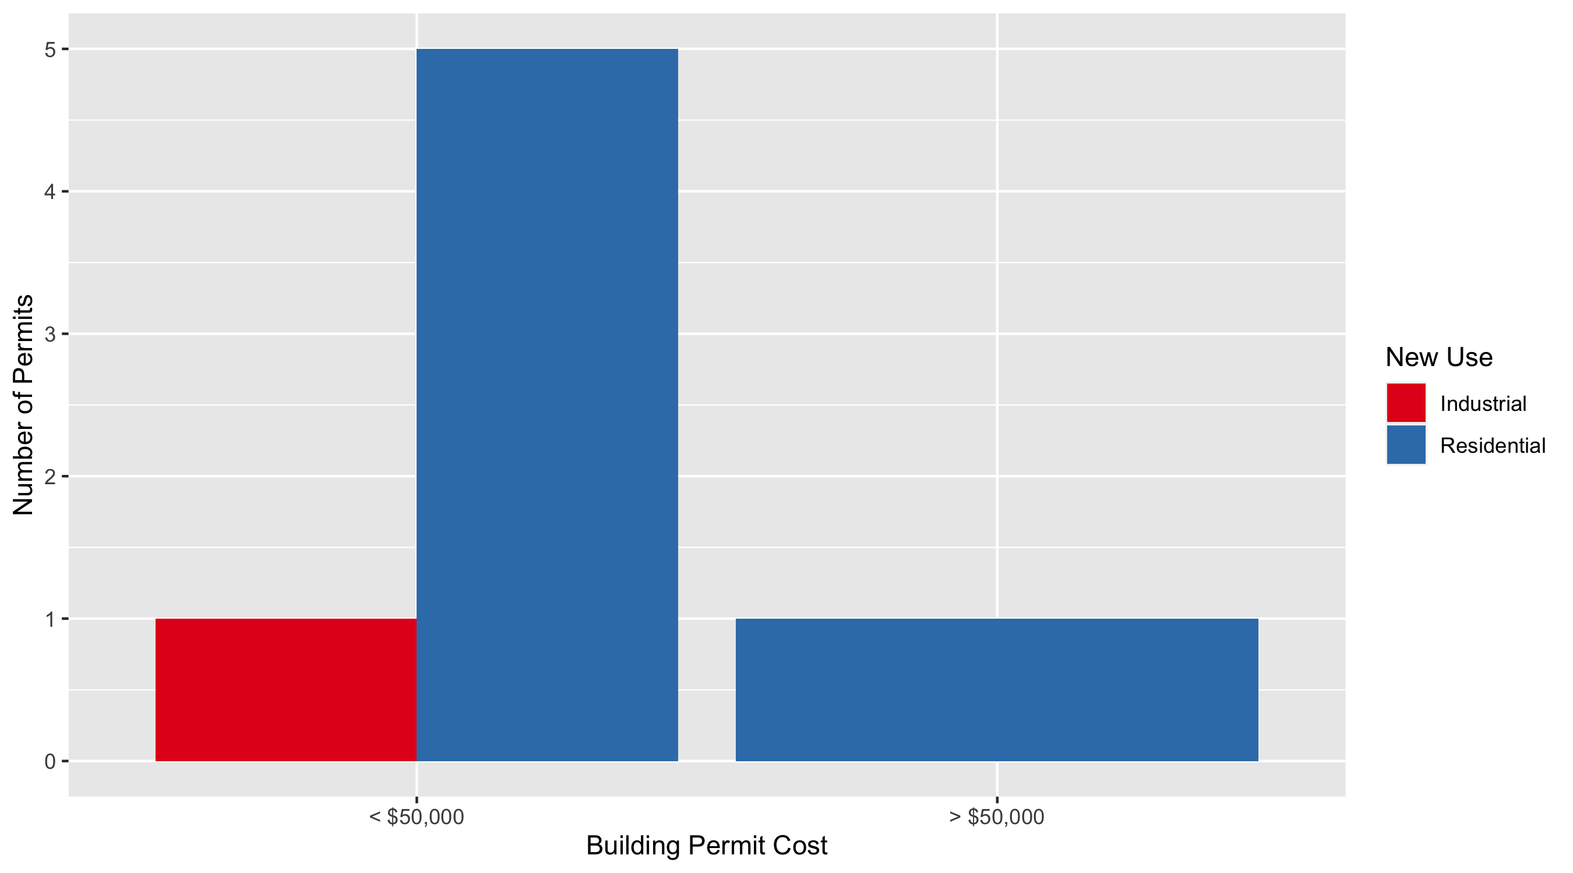
Academy Permit Cost Breakdown

Slide 47
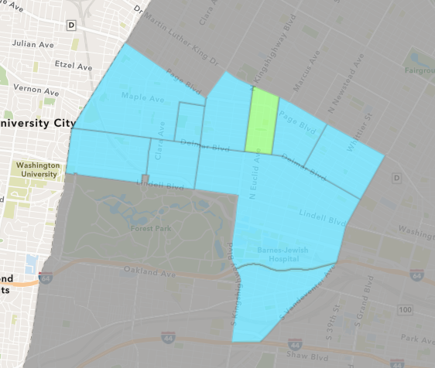
Fountain Park
September 2021 Neighborhood Cost Breakdown
Mean: $12,000
Median: $12,000
Range: $12,000 - $12,000

Slide 48
Fountain Park: Summary Notes
1 building permits in September 2021
Infinite change compared to September 2020 (0 total building permits)
$12,000: Average building permit cost in September 2021
Infinite change compared to September 2020 ($0)
15 total building permits in 2021
275.00% change YTD compared to this time in 2020 (4 total building permits)
$435,930: YTD average building permit cost in 2021
7320.09% change YTD compared to this time in 2020 ($5,875)

Slide 49
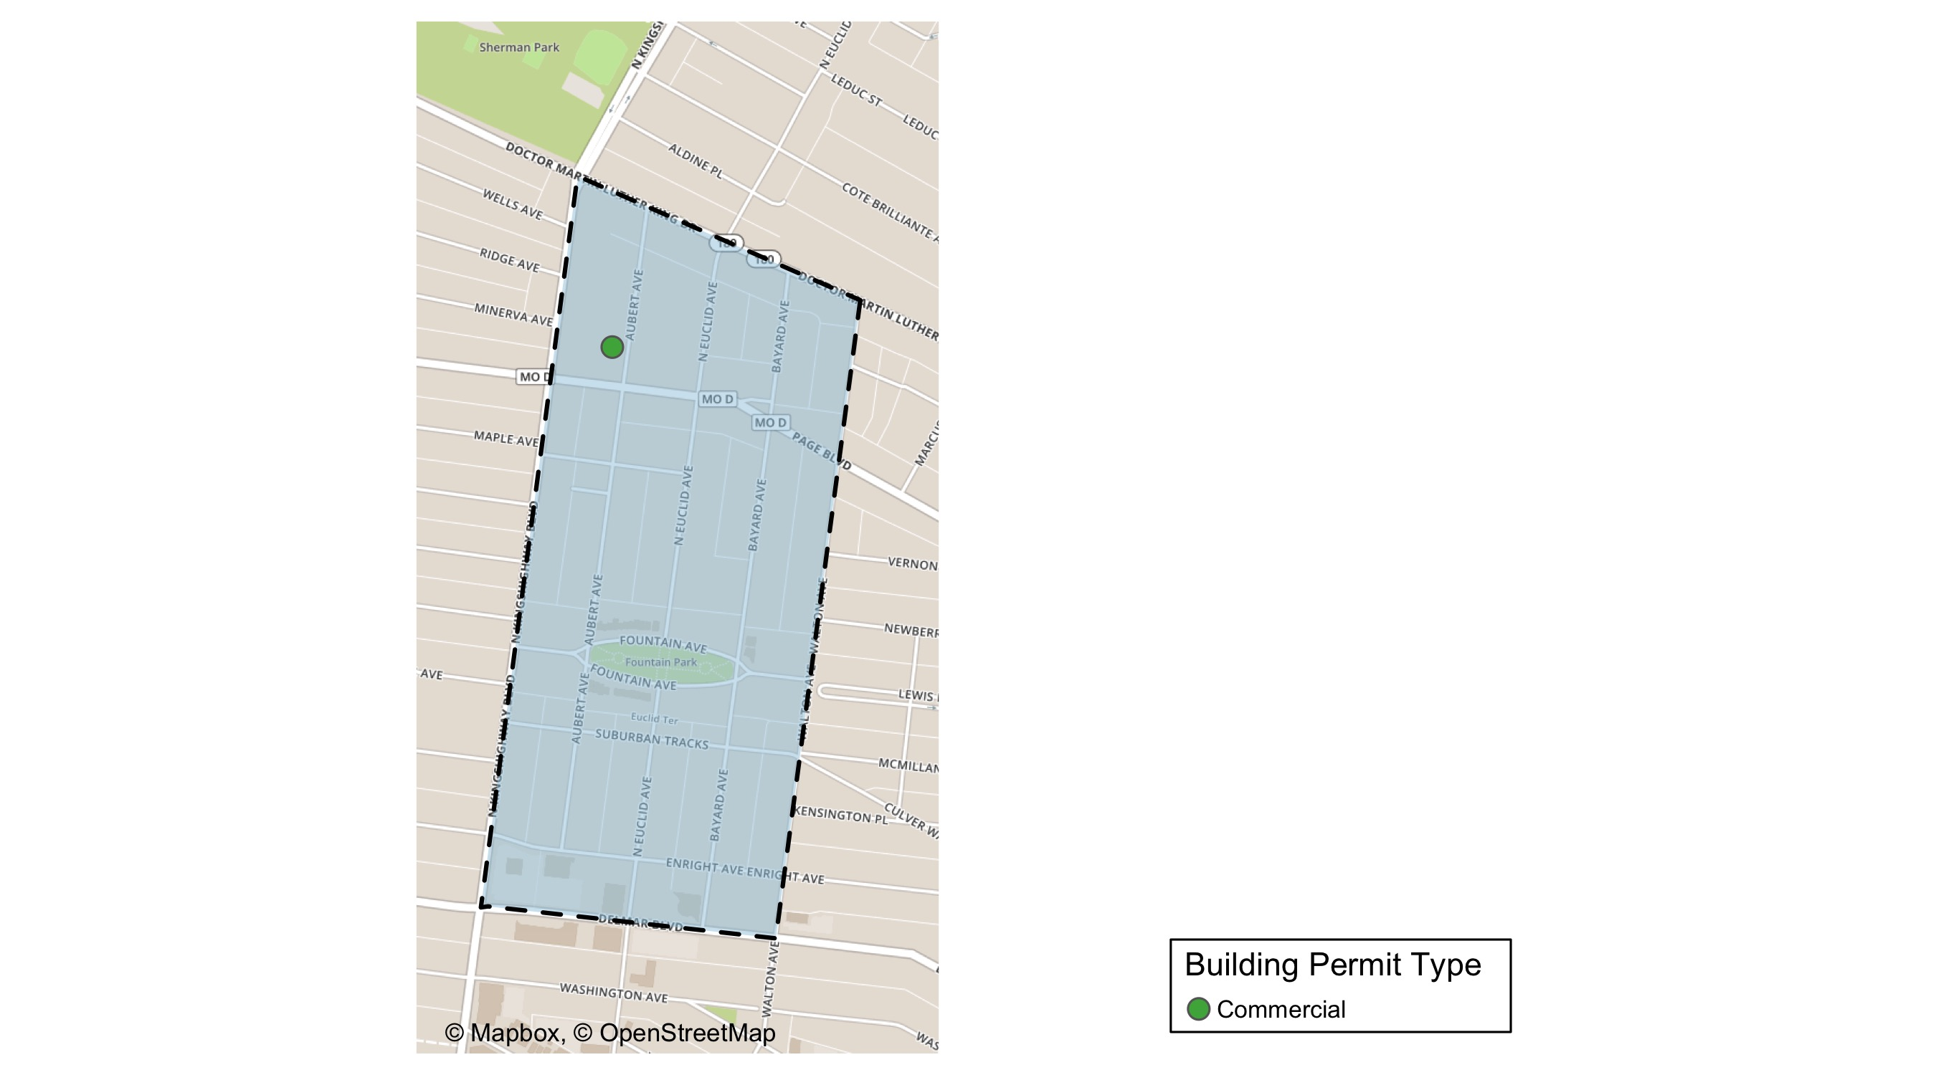
Fountain Park

Slide 50
Neighborhood Summary
September 2021 | September 2021 | September 2021 | September 2021
Permit Use | Average Cost | # of Permits | Total Value of Permits
Commercial | $12,000 | 1 | $12,000
Industrial | $0 | 0 | $0
Residential | $0 | 0 | $0
Last 6 Months | Last 6 Months | Last 6 Months | Last 6 Months
Permit Use | Average Cost | # of Permits | Total Value of Permits
Commercial | $893,604.00 | 4 | $3,574,416
Industrial | $25,000.00 | 1 | $25,000
Residential | $12,773.75 | 8 | $102,190

Slide 51
Fountain Park Individual Permit Breakdown
nbhd_name | Owner | New Use | Cost | address
Fountain Park | ROBERTS PLAZA LLC | Commercial | $12,000 | 1315 AUBERT AV

Slide 52
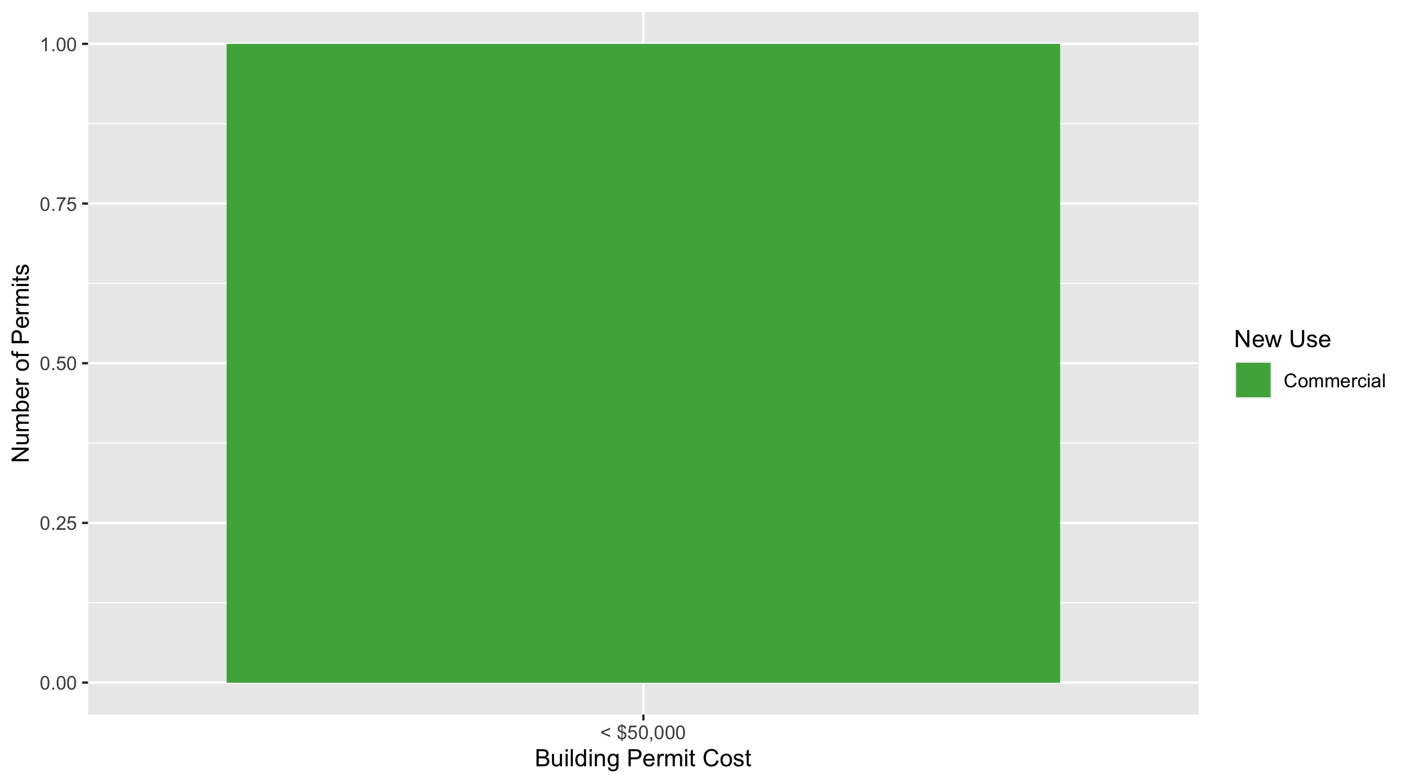
Fountain Park Permit Cost Breakdown

Slide 53
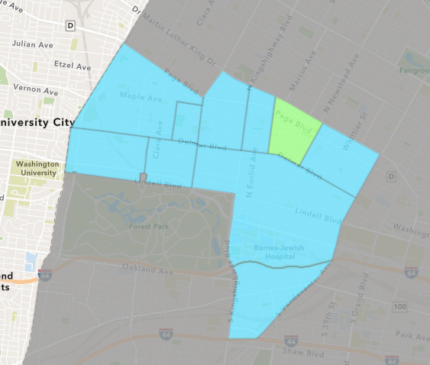
Lewis Place
September 2021 Neighborhood Cost Breakdown
Mean: $5,000
Median: $5,000
Range: $5,000 - $5,000

Slide 54
Lewis Place: Summary Notes
1 building permits in September 2021
-66.67% change compared to September 2020 (3 total building permits)
$5,000: Average building permit cost in September 2021
-91.17% change compared to September 2020 ($56,597)
14 total building permits in 2021
100.00% change YTD compared to this time in 2020 (7 total building permits)
$91,386: YTD average building permit cost in 2021
262.52% change YTD compared to this time in 2020 ($25,209)

Slide 55
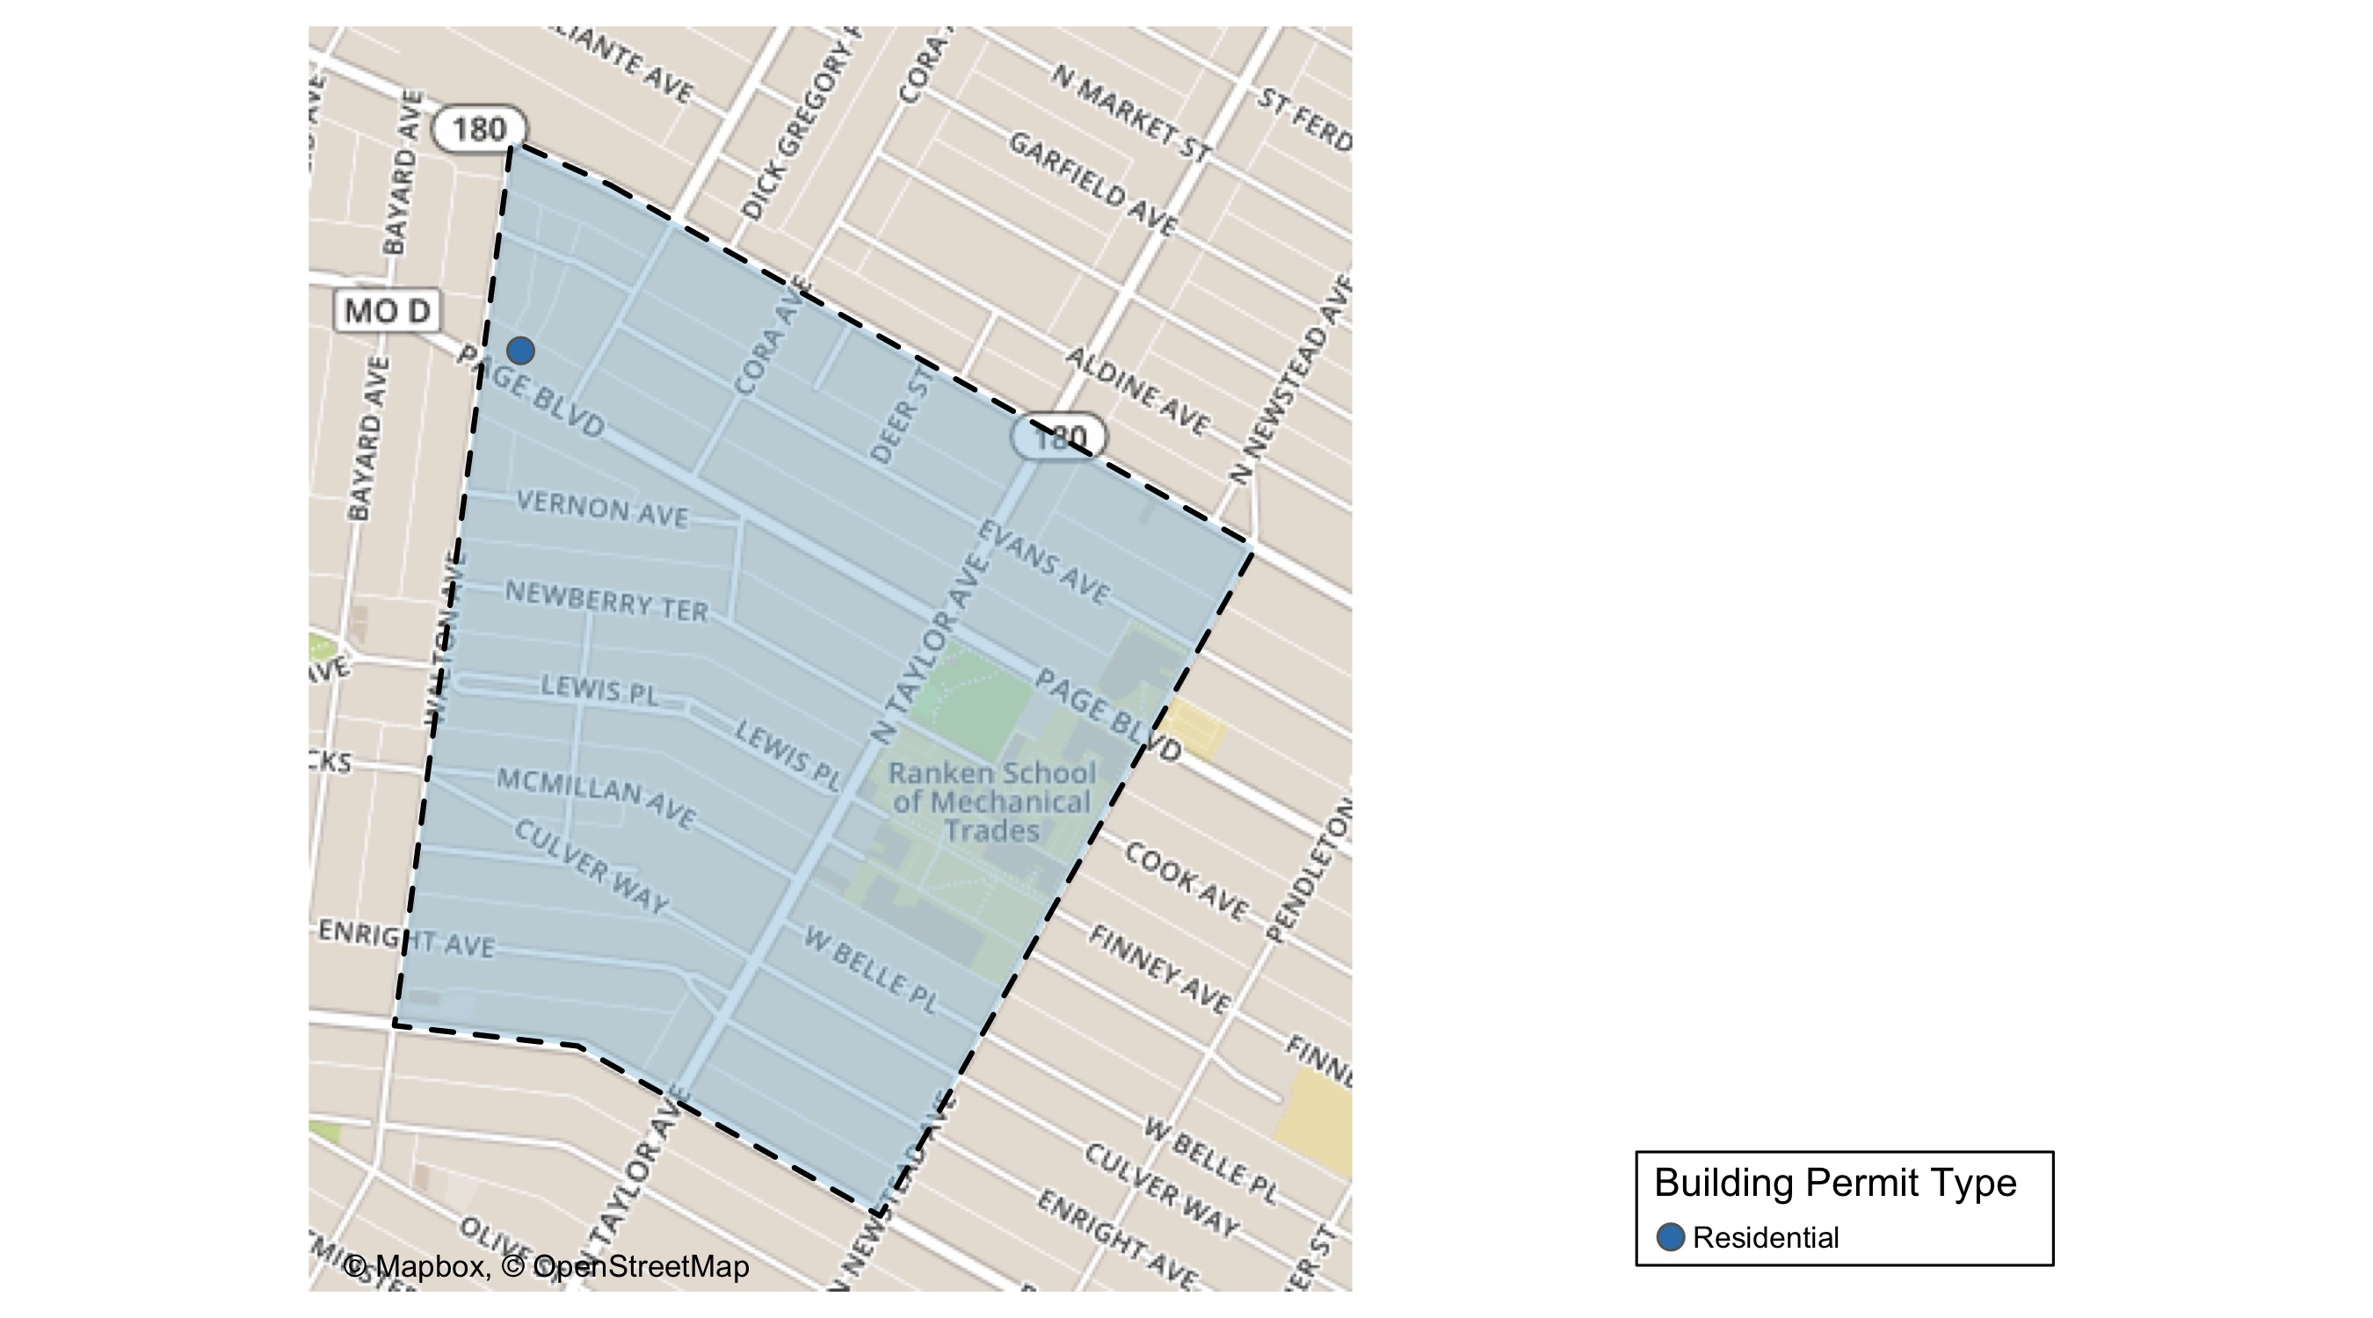
Lewis Place

Slide 56
Neighborhood Summary
September 2021 | September 2021 | September 2021 | September 2021
Permit Use | Average Cost | # of Permits | Total Value of Permits
Commercial | $0 | 0 | $0
Industrial | $0 | 0 | $0
Residential | $5,000 | 1 | $5,000
Last 6 Months | Last 6 Months | Last 6 Months | Last 6 Months
Permit Use | Average Cost | # of Permits | Total Value of Permits
Commercial | $279,084.000 | 4 | $1,116,336
Industrial | $56,000.000 | 1 | $56,000
Residential | $7,877.571 | 7 | $55,143

Slide 57
Lewis Place Individual Permit Breakdown
nbhd_name | Owner | New Use | Cost | address
Lewis Place | GRAVES, JOHN E | Residential | $5,000 | 4727 PAGE BLVD

Slide 58
Lewis Place Permit Cost Breakdown

Slide 59
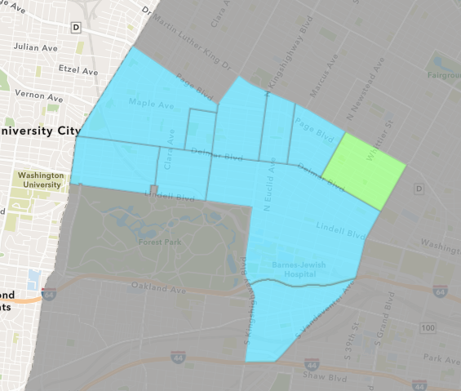
Vandeventer
September 2021 Neighborhood Cost Breakdown
Mean: $250,667
Median: $375,000
Range: $2,000 - $375,000

Slide 60
Vandeventer: Summary Notes
3 building permits in September 2021
200.00% change compared to September 2020 (1 total building permits)
$250,667: Average building permit cost in September 2021
72.87% change compared to September 2020 ($145,000)
11 total building permits in 2021
22.22% change YTD compared to this time in 2020 (9 total building permits)
$113,482: YTD average building permit cost in 2021
91.95% change YTD compared to this time in 2020 ($59,120)

Slide 61
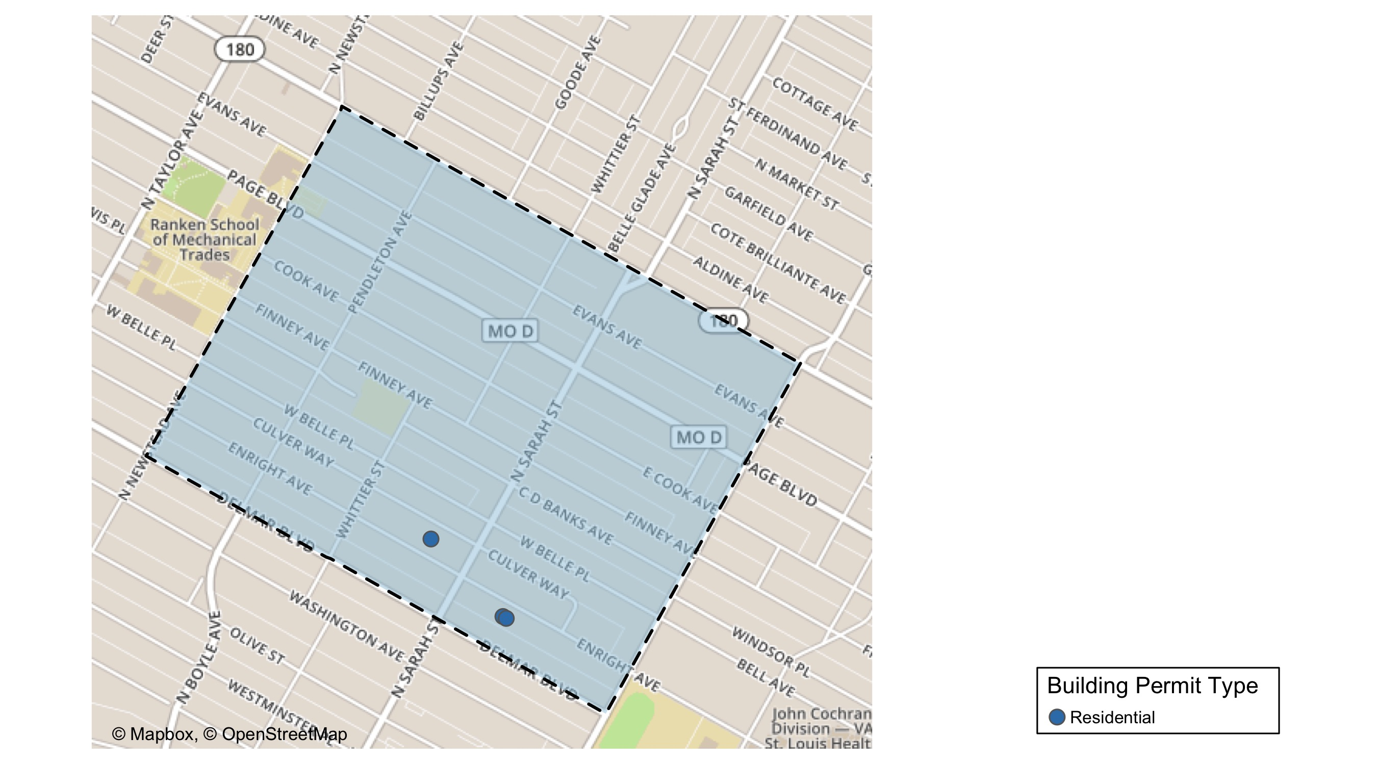
Vandeventer

Slide 62
Neighborhood Summary
September 2021 | September 2021 | September 2021 | September 2021
Permit Use | Average Cost | # of Permits | Total Value of Permits
Commercial | $0.0 | 0 | $0
Industrial | $0.0 | 0 | $0
Residential | $250,666.7 | 3 | $752,000
Last 6 Months | Last 6 Months | Last 6 Months | Last 6 Months
Permit Use | Average Cost | # of Permits | Total Value of Permits
Commercial | $0.0 | 0 | $0
Industrial | $3,650.0 | 2 | $7,300
Residential | $137,888.9 | 9 | $1,241,000

Slide 63
Vandeventer Individual Permit Breakdown
nbhd_name | Owner | New Use | Cost | address
Vandeventer | MINCY, MARRISSA | Residential | $375,000 | 4024 ENRIGHT AV
Vandeventer | MINCY, MARRISSA | Residential | $375,000 | 4028 ENRIGHT AV
Vandeventer | JOHNSON, JAMES | Residential | $2,000 | 4133 ENRIGHT AV

Slide 64
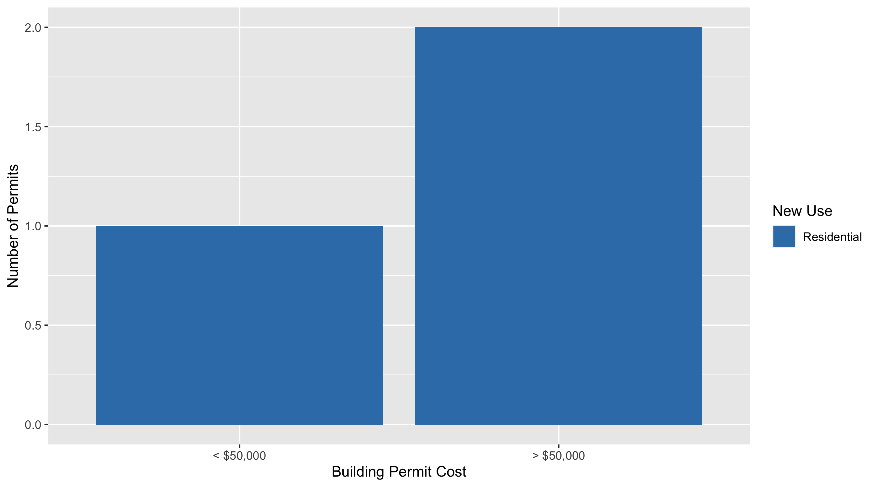
Vandeventer Permit Cost Breakdown

Slide 65
Additional Notes
Data retreived from https://www.stlouis-mo.gov/data/
Building permits with a cost of $0 were dropped
Building permits that were cancelled were dropped
Infinite change indicates 0 permits in the current or previous time period/comparison month so there was a overall increase or decrease

